Slide 1

Data Analytics in Cyber Security (CT115-3-M)(Version E)
Model Logic
Module Code & Module Title
Slide Title
SLIDE 1

Slide 2
TOPIC LEARNING OUTCOMES
At the end of this topic, you should be able to:
To understand concepts in statistics
To understand concepts in statistical modelling
To understand concepts in predictive modelling
To understand concepts in scientific methods
Module Code & Module Title
Slide Title
SLIDE 2

Slide 3
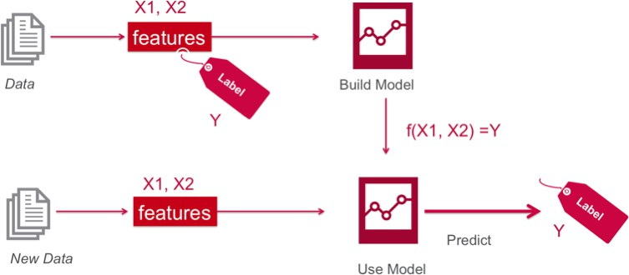
Supervised Learning
That’s nice – but where do the labels come from?

Slide 4

Supervised Learning
The labels come from human intelligence
X: Attributes (Features, Descriptors)
Labeled example / Concept
BP | T | A | G | S | y
: | : | : | : | : | H H NH H NH NH H
: | : | : | : | :
: | : | : | : | :
: | : | : | : | :
: | : | : | : | :
: | : | : | : | :
: | : | : | : | :
: | : | : | : | :
x
y (Label)
Learning “Healthy” Concept
H: Healthy
NH: Not healthy
BP: Blood pressure T: Temperature
A: Age
G: Gender S: Smoking
Supervisor

Slide 5

Contents & Structure
Statistics
Predictive Modeling
Scientific Method
Module Code & Module Title
Slide Title
SLIDE 5

Slide 6
Why Do We Need Statistics?
“Impossible things usually don’t happen.”
- Sam Treiman, Princeton University
Statistics helps us quantify “usually.”

Slide 7

What is a Statistic?
“A quantity that is computed from a sample [of data].”
Merriam-Webster
→ a fact or piece of data obtained from a study of a large quantity of numerical data.

Slide 8
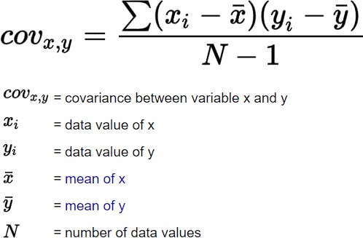
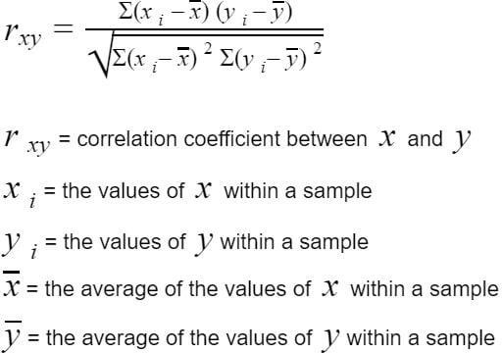
Basics
Independent Events:
  One event does not affect the other
  Knowing probability of one event does not change estimate of another
Covariance:
  Degree that two variables vary with each
other
  Two independent variables have Covariance of Zero
Correlation:
  Normalized Covariance (between –1 and 1)
  Represents degree of linear relationship
  Positive: when one gets bigger, the other gets bigger
  Negative: when one gets bigger, the other gets smaller

Slide 9
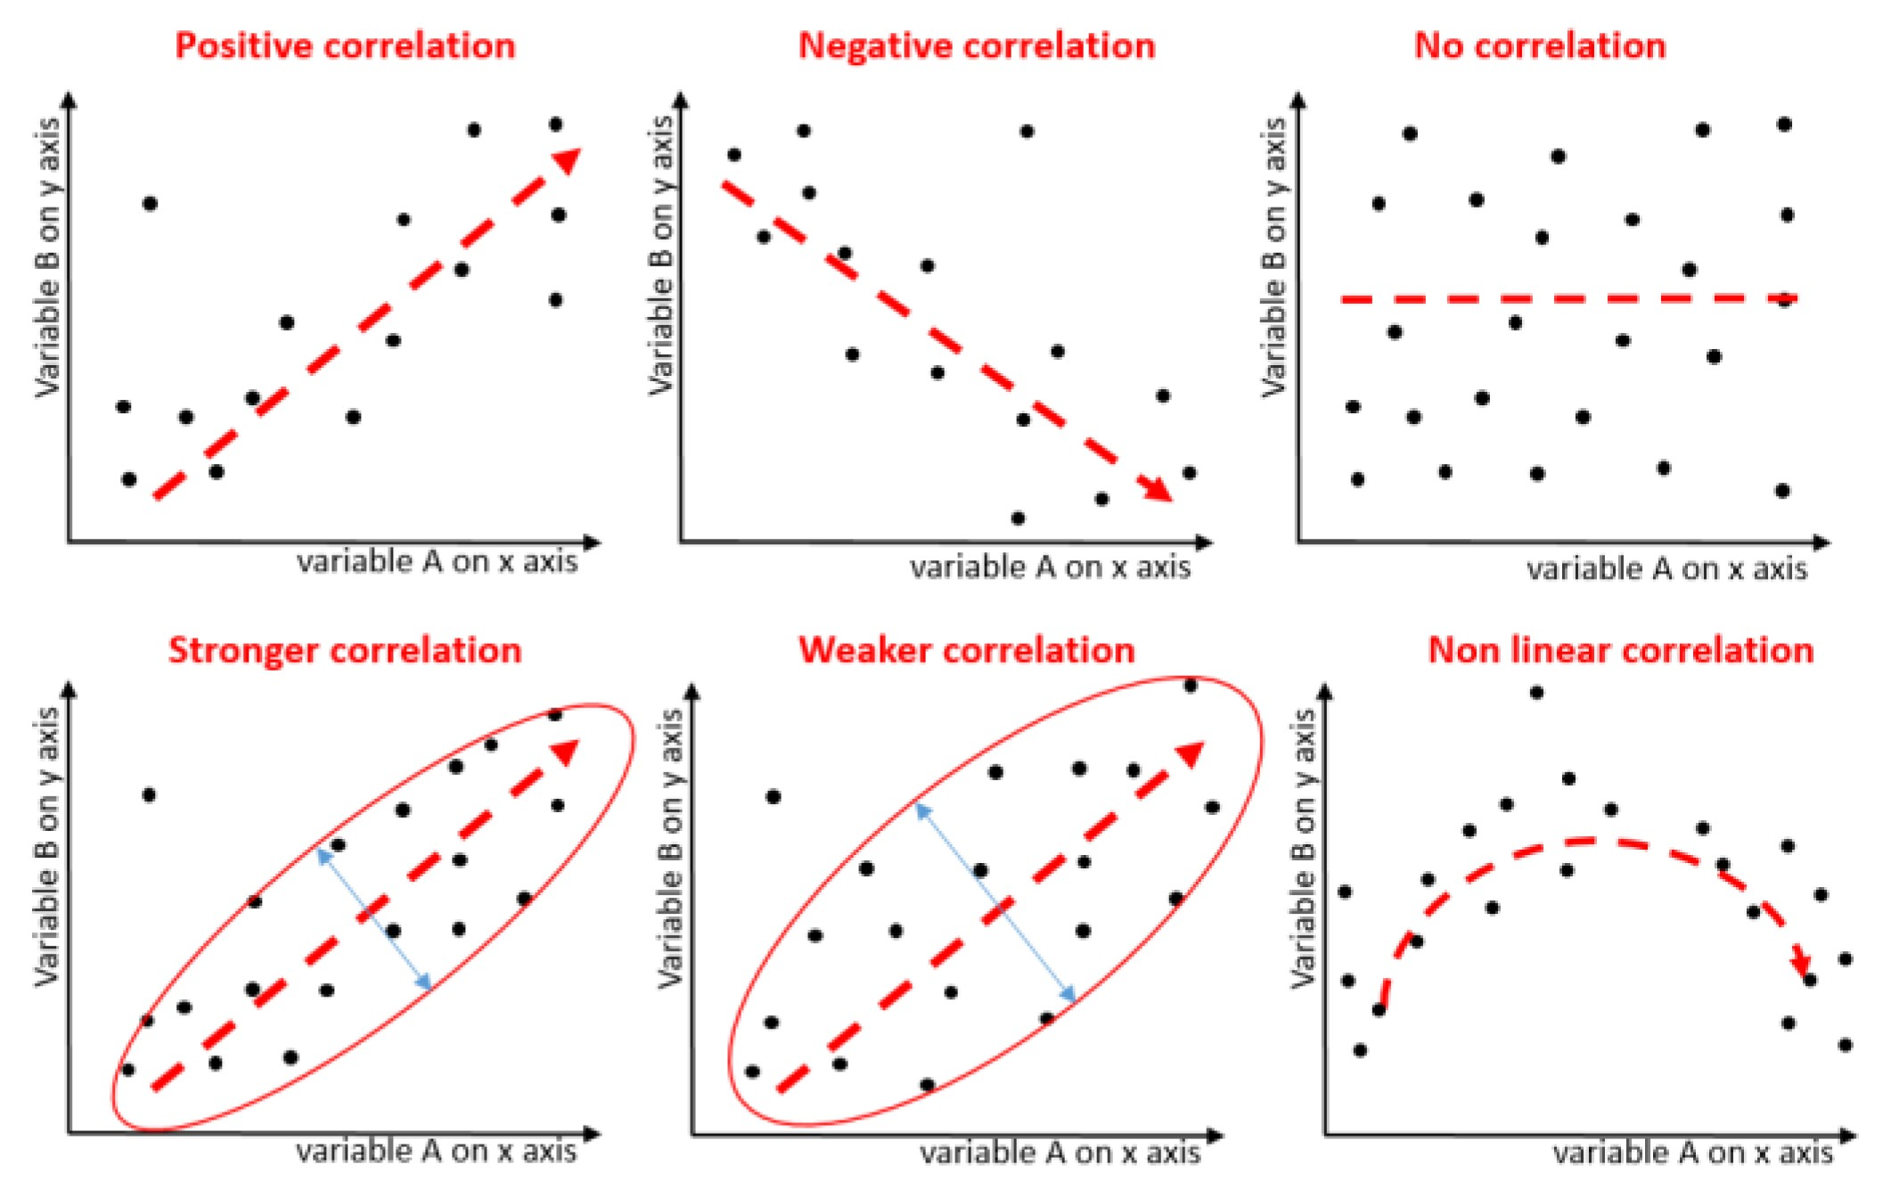
Correlation

Slide 10
Basics
Indices of central tendency
Summarize Data by a Single Number
Three most popular: mean, median, mode
Mean – sum all observations, divide by number of observations
Median – midpoint value when sorted
Mode – most frequent value observed

Slide 11


Relationship Between Mean, Median, Mode
mean
median
modes
mode
mean median
no mode
“Gaussian” or “normal”
mean
“bimodal”
median
mode
mode
Possible in theory
median
mean
median
mean
“skewed”
“skewed”

Slide 12
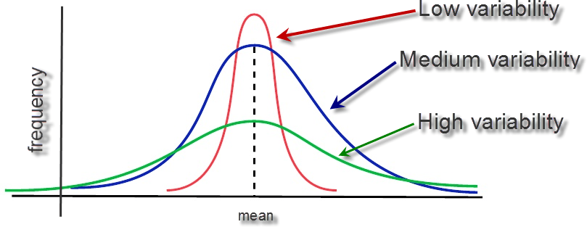
Summarizing Variability
Summarizing by a single number is rarely enough → need statement about variability
– If two systems have same mean, tend to prefer one with less variability
Frequency
Frequency
mean
mean
Response Time
Response Time

Slide 13
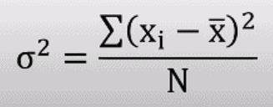
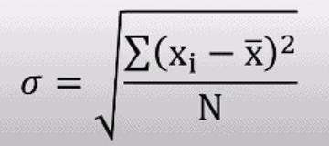
Variance and Standard Deviation
Variance = square of the distance between x and the mean σ² = (x - xത)²
  variance is often denoted σ²
  Also called degrees of freedom
Main problem is units squared
– changing the units changes the answer squared
So, use Standard Deviation σ = sqrt(σ²)
– Same unit as mean, so can compare to mean
Ratio of standard deviation to mean?
  Called the Coefficient of Variation (C.O.V.)
  C.O.V. = σ / µ
  Takes units out and shows magnitude

Slide 14
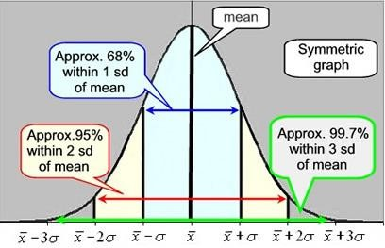
Variance and Standard Deviation

Slide 15
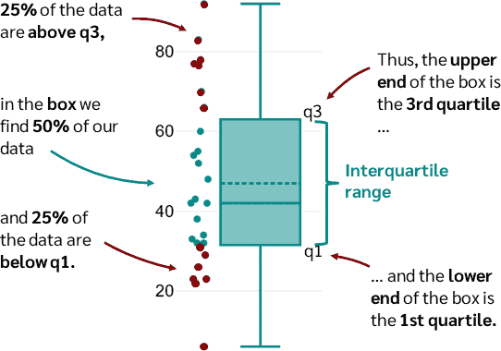
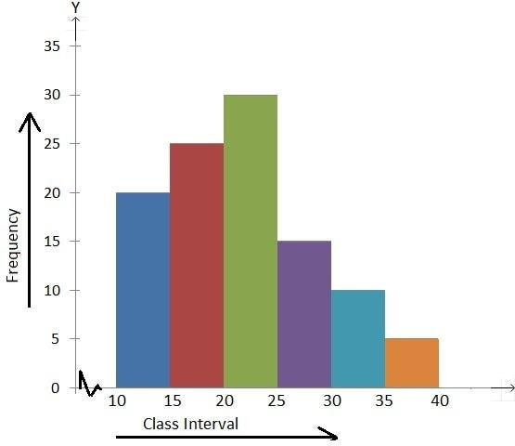
Histogram and Box-Plots
Useful statistical plots that summarise the variability of the data

Slide 16
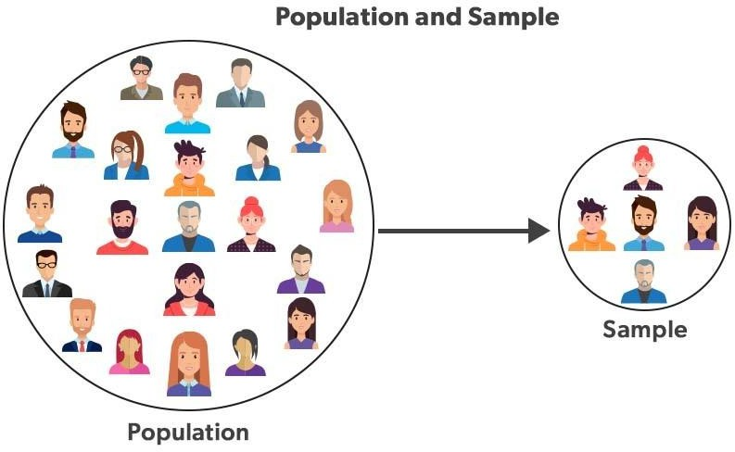
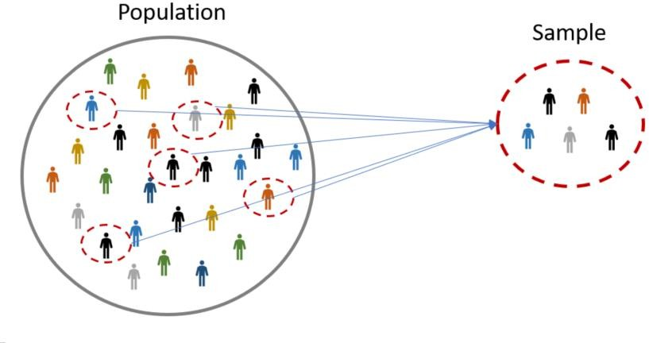
Population versus Sample
Population refers to the entire group or set of individuals, objects, or events being studied, while a sample is a subset of the population that is used for analysis.
The word “sample” comes from the same root word as “example”; one sample does not prove a theory, but rather is an example.
Basically, a definite statement cannot be made about characteristics of all systems. Instead, make probabilistic statement about the range of most systems, i.e., Confidence intervals

Slide 17
Summary
Statistics are tools
  Help draw conclusions
  Summarize in a meaningful way in presence of noise
Indices of central tendency and Indices of central
dispersion
  Summarize data with a few numbers

Slide 18
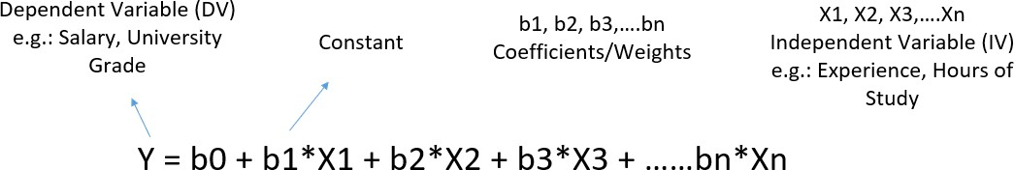
Statistical Modelling / Machine learning
Statistical modelling is the formalization of relationships between variables in the form of mathematical equations.
Machine learning is an algorithm to optimize a performance criterion
using data of particular examples.
Machine learning relies on Statistical modelling

Slide 19
ML/Statistical Modelling
The fewer assumptions in a predictive model, the higher will be the predictive power.
Machine Learning as the name suggest needs minimal human effort.
  Machine learning works on iterations where computer tries to find out
patterns hidden in data.
  Because machine does this work on comprehensive data and is independent of all the assumptions, predictive power can be very strong for these models.
Statistical modelling are mathematics intensive and based on coefficient estimation.
  It requires the modeler to understand the relation between variables before putting them in.

Slide 20
Predictive Modeling
There is a common principle that underlies all supervised machine learning algorithms for predictive modeling.
Machine learning algorithms are described as learning a target function (f) that best maps input variables (X) to an output variable (Y)
Y = f(X)
This is a general learning task where we would like to make predictions in the future (Y) given new examples of input variables (X)
We don't know what the function (f) looks like or its form. If we did, we would use it directly and we would not need to learn it from data using machine learning algorithms.

Slide 21
The Perils of Forecasting
Nobel Laureate Physicist Niels Bohr said:
“Prediction is very difficult, especially if it’s about the future.”
Henri Poincare was more positive:
“It is far better to foresee even without certainty than not to foresee at all.”
Anonymous quotes about the perils of forecasting:
“Forecasting is the art of saying what will happen, and then explaining why it didn’t.”
“There are two kinds of forecasts: lucky and wrong.”
“A good forecaster is not smarter than everyone else; he merely has his ignorance better organized.”

Slide 22
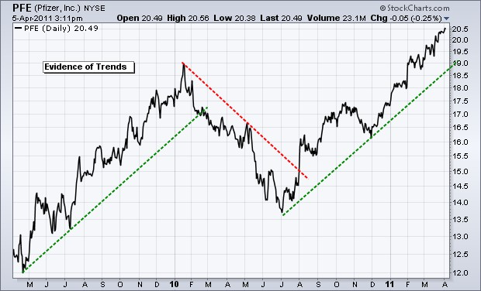
Share Price Prediction
Models try to predict behavior or range of behaviors

Slide 23
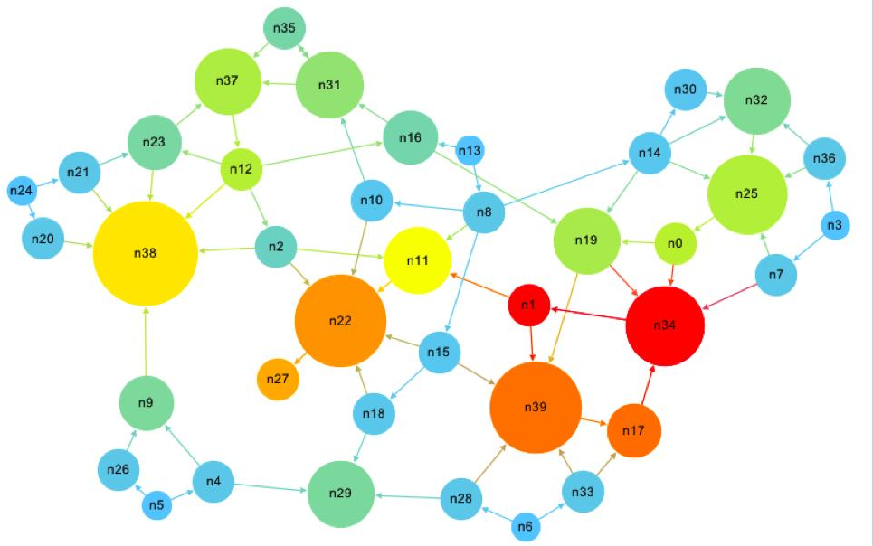
Google’s “Pagerank” Algorithm
Algorithm to rank the hits so the “most useful” ones come first
Google takes your profile, interests, and previous searches
into account

Slide 24
Success Factors
Data and domain understanding
  Generation of data and task
  Cleaning and representation/transformation
Statistical insights
  Statistical properties
  Test validity of assumptions
  Performance measure
Modeling and learning approach
  Choice or development of most suitable algorithm
  Experiments, Scientific Method (Test, Test, Test)
  Model Validation

Slide 25
Scientific Methods
In science, there is a constant interplay between inductive inference (based on observations) and deductive inference (based on theory),
In science, the goal is to get closer and closer to the 'truth,' which we can only approach but not ascertain with complete certainty.
In science, like everyday life, most people accept that the usefulness of a theory based on partial knowledge and probabilities is more important than its absolute validity.

Slide 26
Inference
In the words of the American philosopher C.S.Peirce:
“Deduction proves that something must be; – If A and B then always C
Induction shows that something actually is operative;
– If A and B then most probably C
Abduction merely suggests that something may be.”
– If A and B then C ?
Charles Sanders Peirce, “Pragmatism and Abduction,” (lecture, Harvard University,Cambridge, MA, May 14, 1903), In The Collected Papers of Charles Sanders Peirce, vol. 5, Pragmatism and Pragmaticism, 180-212, CP 5.186, C. Hartshorne and P. Weiss, eds. (Cambridge, MA: Harvard University Press, 1934)

Slide 27
Deductive Reasoning
Deduction is the process of deriving the consequences of what is assumed. If the assumptions are true, a valid deduction guarantees the truth of the conclusion.
In other words, the deductive approach begins with a hypothesis, and we predict what the observations should be if the hypothesis is correct.
These predictions are tested with experiments, and the outcomes of the experiments support or refute our predictions (hypotheses)
– We use deductive constructs (association rules) of the form if A and B then C to help explain observations all the time

Slide 28
Inductive Reasoning
Where the deductive approach goes from the general (theory) to the specific (observations), the inductive approach goes from the specific to the general.
We make many observations, discern a pattern, and infer a general explanation
This is commonly referred to as empirical logic – logic derived from observations about the world.

Slide 29
Inductive Reasoning
With induction, we observe as much as we can about the world and then define general laws based on a number of observations or experiences of recurring patterns.
Each observation is a complete and separate instance from the one before, so the premises of inductive reasoning support the conclusion but do not ensure it.
Slide <#> of 9

Slide 30
Abductive reasoning
Abductive reasoning means forming a premise: what we believe to have happened based on our observations.
The selection criterion is that the hypothesis provides a satisfactory explanation of the observed facts we are interested in explaining
Abductive inference is not so much a process of inventing hypotheses but rather as one of adopting a hypothesis, which is not considered true or verified or confirmed, but seems to be a worthy candidate for further investigation

Slide 31
Abductive reasoning
Things to consider:
Data must be collected before a hypothesis can be formed
Abductive judgements can change, emphasizing or de-emphasizing certain leads.
In this sense, abduction and induction are closely tied: abduction is the end result of the induction process, and the beginning of the deduction process

Slide 32

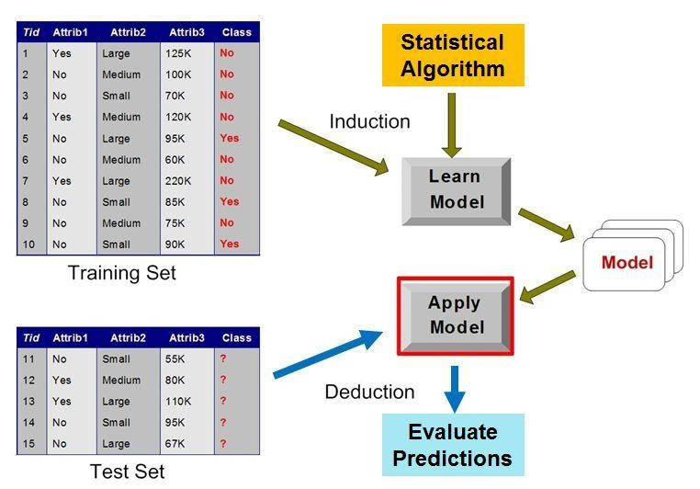
Machine Learning
Statistical Profile

Slide 33
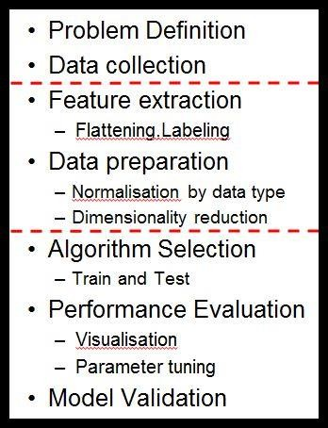
Machine Learning Pipeline
Abductive Reasoning:
Problem Definition
Goal: Decide what information is needed
Methods: Typically, committee meetings, brainstorming, and analysis of business objectives
Outcome: A project specification for the Data Scientists.

Slide 34
Further Reading
Why AI can’t solve unknown problems
https://bdtechtalks.com/2021/03/29/ai-algorithms-representations-herbert- roitblat/
Unsupervised learning can detect unknown
adversarial attacks
https://bdtechtalks.com/2021/08/30/unsupervised-learning-adversarial-attacks- detection/
What Google’s AI-designed chip tells us about the
nature of intelligence
https://bdtechtalks.com/2021/06/14/google-reinforcement-learning-ai-chip- design/amp/

Slide 35
Review Questions
What are the concepts in statistics
What is statistical modelling
What is predictive modelling
What are scientific methods
Module Code & Module Title
Slide Title
SLIDE 35

